Slide 1
IPR Term 2 Week 5
T-Tests (part 2)
Dr Hayley Dewe
(Assistant Professor)

Slide 2
Announcements
Catch up on last week, Intro to t-tests
Before moving on to running each type of t-test, you need to understand what they are and what they represent.
Catch up on the lecture and online content (worksheet activities) from last week
Summative lab report
Due 16th March
You should’ve all collected data by now – if you haven’t, please speak to me or your tutors
Guidance will be released soon – including what to do, how it will be marked and a template

Slide 3
Learning Outcomes
After the next three weeks and independent study you should be able to:
Understand the purpose of parametric t-tests (One samples, between-subjects and within-subjects) and when / why to use them.
Understand their non-parametric equivalent tests
Understand how the data are calculated and analysed.
Run all tests competently in JASP – and understand and interpret the output
Write up and interpret the results following APA standards.
Online content: Run all tests using JASP software using the ‘How to’ videos

Slide 4
Lesson Outline
Quick recap on t-tests – family tree
One-samples t-test (or Wilcoxon signed ranks test)
Paired-samples t-test (or Wilcoxon signed ranks test)
Independent samples t-test (or Mann-Whitney U test)
Online content: run through tests yourself in your own time

Slide 5

recap t-tests

Slide 6
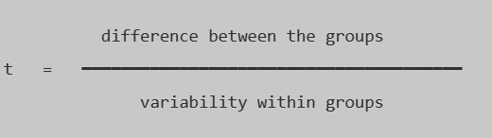
RECAP: What are t-tests?
An inferential statistics test to determine the relationship between an independent variable (categorical data) and a dependent variable (interval, ratio data).
Assumptions:
Independent observations (study design – participants can’t influence each other)
Normality (normally distributed)
Homogeneity of variance (similar spread/variability between groups)
Type of data: interval, ratio (maybe ordinal if meaningful)
Outliers – none or minimal
If all/most assumptions met: Parametric tests (3 x types)
If not, use their Non-Parametric equivalents

Slide 7
T-test family tree
How many groups or conditions in your IV?
Two
One
Who are the participants?
Same participants in each condition
Different participants in each condition
Parametric assumptions met?
Parametric assumptions met?
Parametric assumptions met?
Yes
No
Yes
No
Yes
No
Paired t-test
Wilcoxon signed rank test
Independent t-test
Mann-Whitney U test
One-sample t-test
Wilcoxon signed rank test

Slide 8
2. One-Sample t-test

Slide 9
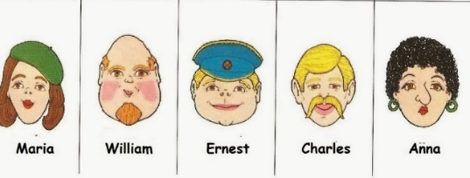
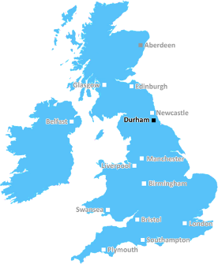

One-sample t-test
(Parametric)
Compare mean Happiness ratings of Durham University sample with a known, average UK population.
Group 1: Happiness ratings of DU students
N = 32, Mean = 20
COMPARED TO
OR, if one or more assumptions are severely violated…run a
Wilcoxon Signed Rank test
Reference: average UK happiness ratings
μ = 18 (population mean)

Slide 10
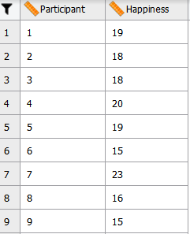
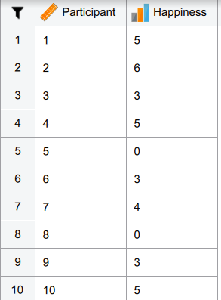
Datasets
I provided two different types of data to be run with each test…
One-Samples t-test
Wilcoxon signed rank test
DV
DV
One row = one participant
One column = their score
Same layout as Parametric, except the test will change the raw data to ranks. μ = 7

Slide 11
3. Paired-Samples t-test

Slide 12
Paired-samples t-test
(Parametric)
Compare participants average happiness ratings after 1 month of exercise with their happiness ratings after 6 months of exercise.
Group 1: Happiness ratings after 1 month of exercise
N = 16, Mean = 19
COMPARED TO
OR, if one or more assumptions are severely violated…run a
Wilcoxon Signed Rank test
Group 1: Happiness ratings after 6 months of exercise
N = 16, Mean = 21

Slide 13
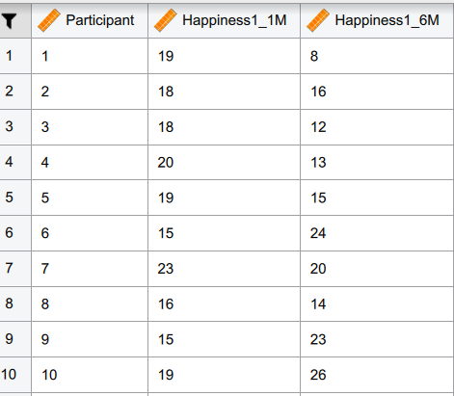
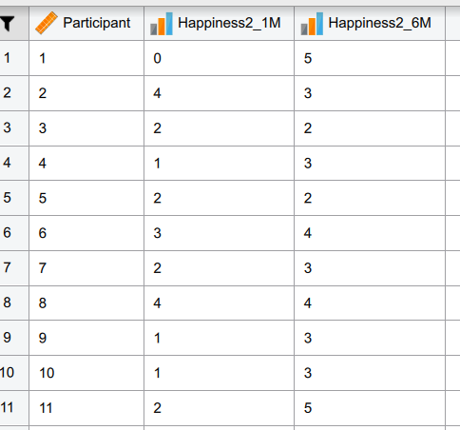
Datasets
I provided two different types of data (1) and (2) in the data sheet to be run with each test…
Paired-Samples t-test
Wilcoxon signed rank test
IV
DV
DV
Same layout as Parametric, except the test will change the raw data to ranks.
One row = one participant
Two columns = two levels of IV
(1 month vs 6 months)

Slide 14
3. independent-Samples t-test

Slide 15
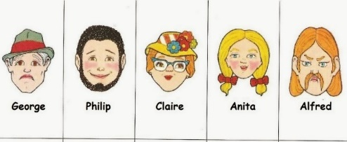
Independent-samples t-test
(Parametric)
Compare average happiness ratings of Group A who completed Aerobic exercise with happiness ratings of Group 2, who completed Strength exercise.
Group 1: Happiness ratings of those who did Aerobic exercise
N = 16, Mean = 17
COMPARED TO
OR, if one or more assumptions are severely violated…run a
Mann-Whitney U test
Group 2: Happiness ratings of those who did Strength exercise
N = 16, Mean = 23

Slide 16
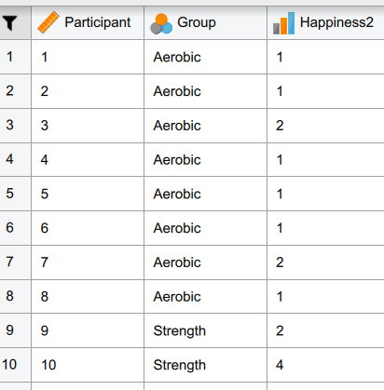
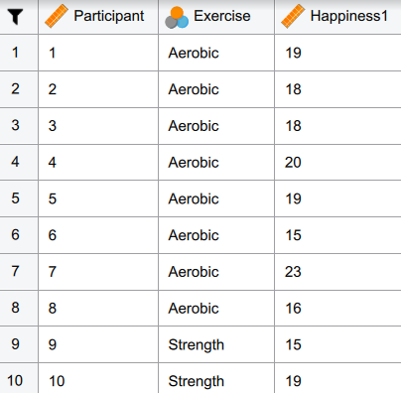
Datasets
I provided two different types of data (1) and (2) in the data sheet to be run with each test…
Independent-Samples t-test
Mann-Whitney U test
IV
DV
Aerobic pps first (Group 1) then Strength pps (Group 2) or mixed (depends how its entered)
Same layout as Parametric, except the test will change the raw data to ranks.
One row = one participant
IV column = two levels (Aerobic vs Exercise)
DV column = happiness ratings

Slide 17
ONLINE CONTENT
Catch up on intro to t-tests (Week 4) if you missed it and do the activities!
Watch the How to Videos to run each test. Practice!

